Slide 1
Arthritis: Rheumatoid Arthritis & Osteoarthritis
A chronic, systemic autoimmune disease of unknown etiology
Leads to abnormalities of cartilage and bone and progressive joint destruction
Characterized by symmetric, erosive, diarthrodial joint synovitis
May involve multiple organ systems: CV, pulmonary, renal, hematologic, peripheral nervous systems, skin and eyes
Female-to-male ratio 3:1
Strong association with Class II major histocompatibiilty complex HLA:
HLA-DR4 – N European & Americans
HLA-DR1 – Italian, Israel Jewish, some Hispanics
HLA-DR14 – Yakima Indians

Slide 2
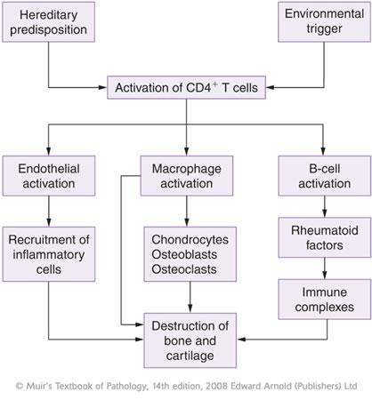
Pathophysiology of Rheumatoid Arthritis

Slide 3
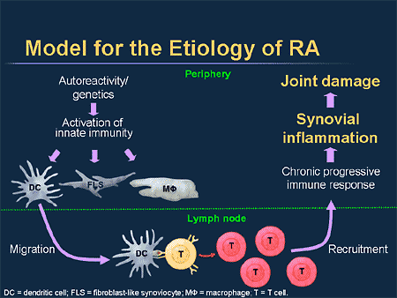
Pathophysiology of Rheumatoid Arthritis
http://www.medscape.org/viewarticle/488955

Slide 4
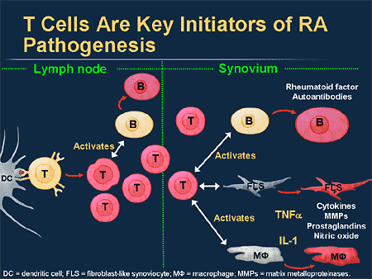
Pathophysiology of Rheumatoid Arthritis

Slide 5
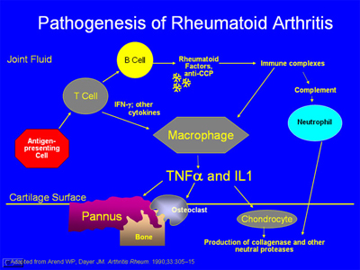

Slide 6
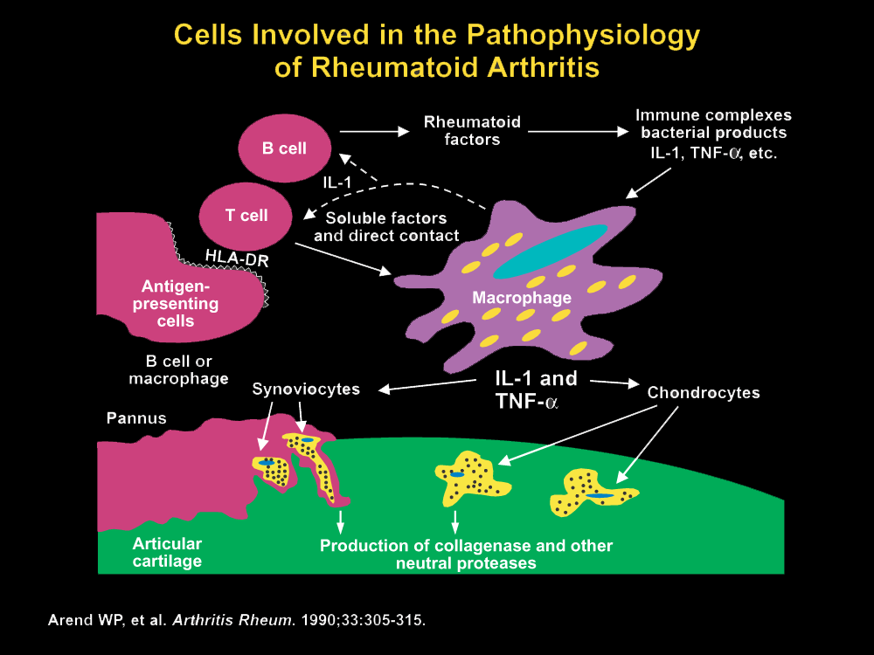
Pathophysiology of Rheumatoid Arthritis

Slide 7
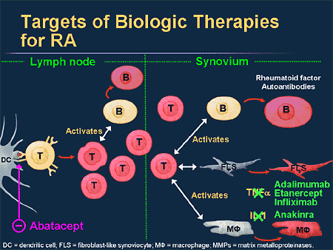
Pathophysiology of Rheumatoid Arthritis

Slide 8
Macrophages
Secrete cytokines (IL-1, IL-6) which attract lymphocytes
Begin damage to joint
Act as Antigen Presenting Cells
Activation of T Lymphocytes
Co-stimulation
T Cells
Attach antigen presented in attempt to clear it from body
Secrete additional cytokines (IL-2, TNF-α) which leads to inflammation and destruction of cartilage and joint matrix
B Cells
Secrete antibodies against antigen which attract other lymphocytes and neutrophils which release cytotoxic factors (cytokines, free radicals, complement) and cause joint damage
IgM--rheumatoid factor, autoantibodies
Rheumatoid Factors: Most common autoantibody in RA – Usually an IgM antibody, less often an IgG or IgA antibody

Slide 9
Structural Pathology
Joint involvement
Must have involvement of at least 3 joint areas simultaneously
Any joint, usually knee or smaller joints of hands and feet involved first (MCP, PIP, DIP, MTP, wrist)
Typically symmetrical
Morning stiffness, stiffness after inactivity
Decreased grip strength, pinching/fine motor movement pain
Late stages: joint instability, ulnar deviation or other permanent deformity muscle atrophy
Joint destruction
Inflammatory reaction in synovium, hyperplasia
Formation of pannus → spreads inflammatory reaction to surrounding cartilage and bone
Introduction of vasculature → proliferation of immune reaction
Fibrosis of cartilage, tendons, ligaments and other supportive structures
Decreased joint range of motion, pain, instability

Slide 10
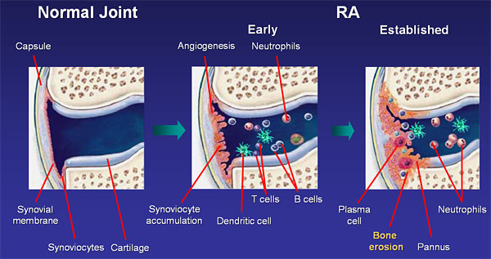
Pannus: an abnormal layer of fibrovascular tissue or granular tissue

Slide 11
Structural Pathology
Systemic Signs & Symptoms:
Fatigue
Subcutaneous nodules (rheumatoid nodules)
Vasculitis
microvascular infarcts around fingers, toes
skin breakdown, ulcers
rarely, infarction of large vessels or organ involvement
Pleural/pulmonary disease
Pericardial/cardiac disease
Corneal/conjunctival disease
Lymphadenopathy, splenomegaly
Anemia of chronic disease

Slide 12
Structural Pathology
Lab or Radiographic Abnormalities
↑ erythrocyte sedimentation rate (ESR)
Normochromic, normocytic anemia
Rheumatoid factors (IgM antibodies)
± Antinuclear antibodies (ANA) or autoantibodies
Systemic Sx: fever, ↑ WBC
X-Ray for osteopenia, joint space narrowing, bony erosion, soft tissue swelling
Synovial fluid: large number of leukocytes (> 5,000) & decreased viscosity

Slide 13
Criteria for RA Classification
Morning stiffness in and around joints lasting at least 1 hour before maximal improvement
Soft tissue swelling (arthritis) of three or more joint areas observed by a physician
Swelling (arthritis) of the PIP, MCP or wrist joints.
Symmetric arthritis
Rheumatoid nodules
Positive test for RF
Radiographic erosions or periarticular osteopenia in hand or wrist joints
Presence of 4 of 7 = diagnosis of RA
Poor Prognosis
Male, age >50 Poor functional capacity
Positive RF HLA-DR4 haplotype
Presence of nodules > 20 joints involved

Slide 14
Overview of TX for RA
Initial Therapy:
Physical/occupational Tx
DMARDs (Disease-modifying antirheumatic drugs) within the 1st three months - methotrexate, sulfasalazine, leflunomide, hydroxychloroquine, gold salts
NSAIDs for temporary relief of pain & inflammation (see school slides for details)
Possible local or oral steroids
Criteria for complete clinical remission in RA
A minimum of 5 of the following requirements must be fulfilled for at least 2 consecutive months in a patient with RA:
Morning stiffness not > 15 minutes
No fatigue
No joint pain
No joint tenderness or pain on motion
No soft-tissue swelling in joints or tendon sheaths
ESR < 30 mm/hr (females) or 20 mm/hr (males)

Slide 15
Tx of Rheumatoid Arthritis
Salicylates:
- High doses for anti-inflammatory effects (3-5 g/d or higher)
- Low doses for analgesics effects (< 4 g/d)
NSAIDs: see school slides for details
- Adverse effects
- Drug-drug interactions
- COX-2 inhibitors (Celecoxib) - Rofecoxib & Valdecoxib removed from market
DMARDs (disease-modifying anti-rheumatic drugs): similar class to NSAIDs and steroids
- Methotrexate
- Leflunomide
- Hydroxychloroquine
- Sulfasalazine
- Penicillamine
- Gold
- Azathioprine
- Cyclosporine
- Biologicals (monoclonal antibodies)
Synthetic DMARDs

Slide 16
Methotrexate
Considered by most rheumatologists to be the gold standard of DMARDS
Mechanism:
Impact on immune system
decreased T and B lymphocyte function
folic acid antagonist
interferes with purine biosynthesis
Folic acid 1 mg daily can reduce adverse effects: mainly stomatitis & possibly myelosuppression and alopecia; no effect on pulmonary toxicity or hepatotoxicity
Leflunomide
Adverse Effects:
Liver toxicity (monitoring is a must) cases of fatal liver toxicity: baseline LFTs then monthly for first 6 months and every 1-2 months thereafter
Teratogenic: Category X
Planned pregnancy: decontamination with cholestyramine: 8 gram TID x 11 days confirm with two leflunomide blood levels 2 weeks apart

Slide 17
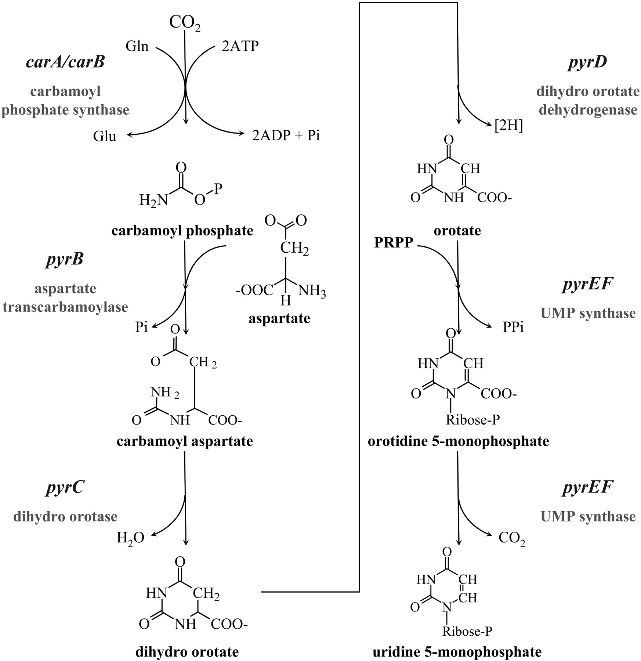
Step 4
Step 1
Leflunomide
Inhibits pyrimidine nucleotide synthesis
Step 2
Antiproliferative effect on T-cells
Step 5
Time to benefit: 1-3 mos
Dosing: 100 mg load x3 days then 10-20 mg/d maintenance
Step 3
Step 6

Slide 18
Hydroxychloroquine
Plaquenil
MOA: Inhibition of macrophages and B cell function, decrease IL-1 secretion, may also affect prostaglandins for anti-inflammatory action
Generally a first line DMARD for milder presentations
Dose: 200 mg po BID
Time to benefit: 2-6 months
ADVERSE effects: rare incidence of vision changes - Baseline eye examination and every 6-12 month
Sulfasalazine
Generally for milder presentation
MOA: Precise mechanism is unclear, may interfere with immune system on level of T and B lymphocytes
Dose: 1 g po BID to TID
Time to benefit: 1-3 months
AE: photosensitivity, rash, myelosuppression

Slide 19
Penicillamine
MOA: Inhibit T cell proliferation by complexing with CU++, may decrease immune complex formation
Slow onset of relief: up to six month
Unpopular due to adverse effects: rash, stomatitis, dysgeusia, myelosuppression, autoimmune reactions
Dose: 250-750 mg po daily
Gold
MOA: Inhibit macrophage and PMN (polymorpho nuclear leukocytes) activity, may decrease immune complex formation (IgG/IgM complexes)
Time to Benefit: 3-6 months
Injectable or oral; injectable > efficacy
Adverse Effects: myelosuppression, thrombocytopenia, rash, stomatitis, proteinuria

Slide 20
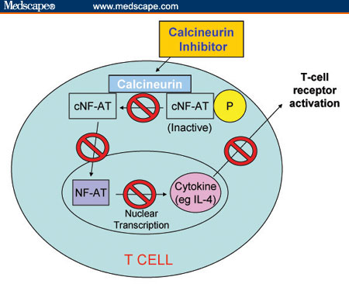
Azathioprine
MOA: inhibitor of lymphocyte proliferation
Time to benefit: 2-3 months
Dose: 50 to 150 mg po daily
Adverse Effects: Myelosuppression, hepatotoxicity, increase LFTs, GI symptoms
Cyclosporine
MOA: Calcineurin inhibitor, preventing the activation of T-Cells
Dosing is lower than in transplant, usually 3 mg/kg/day
Time to benefit: 3-6 months
Adverse Effects: many (defer to your transplant lecture)

Slide 21
Biologicals
Naming convention of monoclonal antibodies by USAN (US Adopted Names Council
The first part of the name is unique and does not hold any particular meaning
The second part of the name is the target of the antibody. it may be two or three letters as shown in the table below. When the third part of the name (source) starts with a vowel then the second part has 3 letters.
The third part of the name is the source. This is the source of the antibody.
2nd part - Target of antibody
Bac for bacterial
col for colon tumor
gov for gonad/ovarian tumor
lim for immunomodulation
mel for melanoma
toxa for toxin as a target
vir for viral
ci ( r) for cardiovascular
Les for infectious lesions
tum for tumor not specified
mar for mammary tumor
http://www.nhlcyberfamily.org/treatments/moab.htm

Slide 22
The first part of the name is unique and does not hold any particular meaning
The second part of the name is the target of the antibody. it may be two or three letters as shown in the table below. When the third part of the name (source) starts with a vowel then the second part has 3 letters.
The third part of the name is the source. This is the source of the antibody.
3rd part - Source
u = human o = mouse a = rat zu = humanized e = hamster i = primate xi = chimera axo = rat/mouse xizu = combination of humanized and chimeric chains
Ending letters “mab” = monoclonal antibody
http://www.nhlcyberfamily.org/treatments/moab.htm

Slide 23
RI TU XI MAB
Unique name for drug
Monoclonal antibody
SOURCE
Chimeric
TARGET
Tumor
Not specific
For example Rituximab is made up of RI the unique name, TU(m) the target (misc tumour), and XI the source (chimeric) and MAB=monoclonal antibody.
Chimera: a single organism composed of genetically distinct cells

Slide 24
Summary of Biologicals for Tx of RA
TNF-α Inhibitors | Infiximab Etanercept Adalimumab Golimumab Certolizumab
IL-1 Inhibitor | Anakinra
IL-6 Inhibitor | Tocilizumab
Janus Kinase (JAK) Inhibitor | Tofacitinib
Anti-CD20 Blocker | Rituximab
Co-Stimulator Blocker | Abatacept

Slide 25
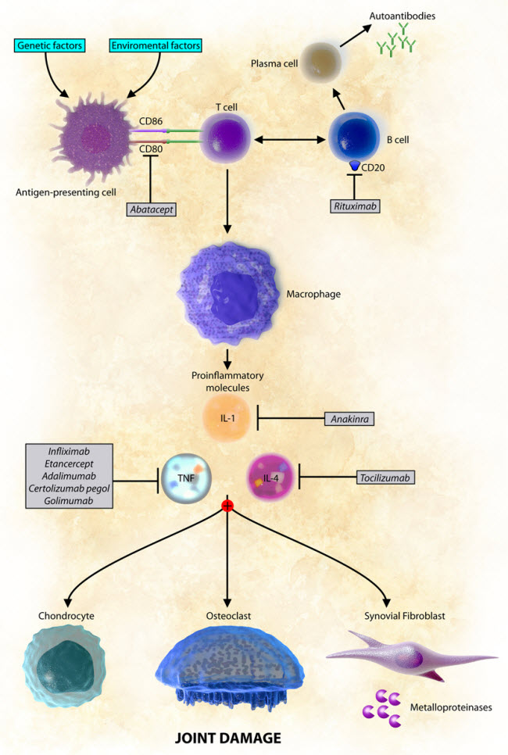
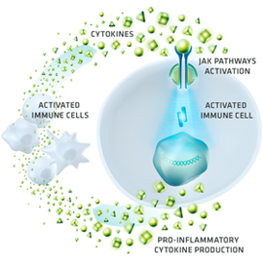
Summary of Biologicals for Tx of RA
Tofacitinib

Slide 26
TNF-α Inhibitors
Not first line therapy
Generally used when patients are not achieve goal remissions with DMARD therapy (ies).
Adverse effect profiles similar
Adverse Effects:
Infusion related reactions with infliximab
Reactivation of latent TB
Infection
Unrecognized Invasive Fungal Infection
Myelosuppression
Post marketing reports of secondary malignancy/lymphoma
Post marketing reports of demyelination of CNS and heart failure
New onset of psoriasis
A member of a group of cytokines produced by activated macrophages that stimulate the acute phase reaction (inflammation).
The primary role of tumor necrosis factor (TNF) is in the regulation of immune cells

Slide 27
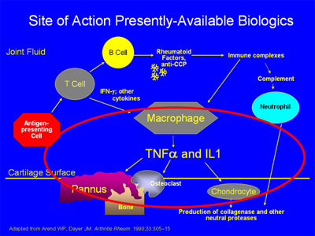
TNF-α Inhibitors

Slide 28
Biologics for RA
TNF-α inhibitors
Adalimumab, Etanercept, Infliximab
Newly approved Golimumab and Certolizumab
These agents bind specifically to TNF-α and neutralize the biological activity of this pro-inflammatory cytokine
This decreases the infiltration of inflammatory cells into inflamed areas of the joints.

Slide 29
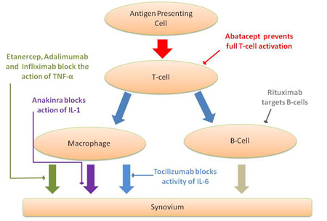
Biologics for RA
TNF-α inhibitors
Infliximab, Etanercept, Adalimumab
Newly approved Golimumab and Certolizumab

Slide 30
2006 AWP
Adalimumab: $20,000 to 40,000 annually
Etanercept: $20,000
Infliximab: $10,000 to $60,000
Biologics for RA
Dosing of TNF-α Inhibitors
Adalimumab:
40 mg sc every two weeks
Etanercept:
25 mg sc twice weekly or 50 mg sc once weekly
Infliximab: IV infusion
3 mg/kg IV over 2 – 4 hours
Some may increase to 10 mg/kg
Week 0, 2, 6 and then q8week maintenance infusion
Golimumab: Simponi
50 mg subq once monthly
Certolizumab: Cimzia
Initial 400 mg Subq (two 200 mg injections)
Repeat 400 mg at week 2 and week 4
maintenance: 200 mg every other week or 400 mg once a month

Slide 31
Interleukin Inhibitors
Anakinra
(Recombinant inhibitor of interleukin 1)
Tocilizumab
(Interleukin-6 receptor antagonist)
http://www.medscape.org/viewarticle/745566_3

Slide 32
Interleukin Inhibitors
Anakinra
Recombinant inhibitor of interleukin 1
100 mg sc daily
Monthly cost $1300
Different mechanism than TNF-α Inhibitors so would seem attractive to use together
FDA warnings about using concomitantly due to increased risk of infections and neutropenia
Tocilizumab
Interleukin – 6 receptor antagonist
Antagonism of this receptor leads to a reduction of this cytokine and acute phase reactant production
Treatment of moderately to severly active RA who have had an inadequate response to one or more TNF antagonists
Can and is used in combination with non-biologic DMARDs
Dose: Initial 4 mg /kg IV every 4 weeks
May be increased to 8 mg/kg IV based on clinical response
Max 800 mg per infusion
Infuse over 4 hours
In addition to risk of infusion related reactions and infections
Liver Toxicity & Cytopenias

Slide 33
Co-Stimulator Blockers
Abatacept
Co-stimulator blocker
Blockers earliest activation of T cells
500-1000 mg IV depending on weight
Week 0, week 2, week 4 and then every 4 weeks
Currently on restrictive distribution
AWP/dose $1000-2000
Decrease cytokine release from activated macrophages
Decreased B cell activation and autoantibody production
Decreased Inflammatory markers
Malignancy and infections most serious of the adverse effects
Generally considered only when patients have failed DMARD + Biological therapy (such as TNF α inhibitors)

Slide 34
Co-Stimulator Blockers
APC
MHC
CD80/CD86
Antigen
Abatacept
CD 28
T cell

Slide 35
Janus Kinase Inhibitor
The production of excess pro-inflammatory cytokines by activated immune system cells triggers the recruitment of additional immune system cells to the synovium. Infiltration by these immune system cells perpetuates inflammation, continuing the loop of inflammatory signaling
Tofacitinib (Xeljanz)
Tofacitinib deactivates JAK
JAK, Janus kinase
http://www.xeljanzhcp.com/mechanism-of-action

Slide 36
Tofacitinib (Xeljanz)
Janus kinase (JAK) inhibitor
Janus kinase enzymes are enzymes that provide signal transduction to active cytokines
Tofacitinib is a JAK3 inhibitor and blocks the activation of cytokines such as IL-2, IL-4, IL-15, IL-21
This is turn blocks the activation of Type 2 T helper cells
To a lesser extent, tofacitinib blocks interferon-gamma and IL-6: leading to block of Type 2 T helper cell differentiation
Indication: Rheumatoid arthritis (monotherapy or in combination with nonbiologic disease-modifying antirheumatic drugs (DMARDs)
Should NOT be use with biologic DMARDs
Should NOT be used with strong immunosuppressants
Tacrolimus
Azathioprine
Cyclosporine

Slide 37
Tofacitinib (Xeljanz)
Black Box warnings
Infections
Disseminated TB
Secondary malignancies
Other significant ADRs
GI perforation
Hepatatoxicity
Lipid abnormalities (Check lipids 4-8 weeks after initiation)
Bone Marrow Suppression (check CBC baseline; then after 4-8 weeks of therapy then every 3 mos)
Dose modifications need for
Lymphopenia
Neutropenia
Anemia

Slide 38
Tofacitinib (Xeljanz)
Drug Interactions:
Contraindicated with other biologic DMARDS and strong immunosuppressants
Dose adjustment needed for concomitant moderate to strong CYP 3A4 inhibitors and potent CYP2C19 inhibitors
Dosing:
Dose: 5 mg po twice daily
Dose adjustment for renal and hepatic impairment (reduce dose to 5 mg daily)
Not recommeded in patients with severe liver impairment or patients with Hep B or Hep C
Cost: 5 mg po BID--$2100 for 30 day supply

Slide 39
Rituximab
First approved for Non-Hodgkins Lymphoma
Anti-CD20 monoclonal antibody
CD 20 marker present on the surface of almost all normal and malignant B cells

Slide 40
Rituximab
Trials showed it to be safe to use in patients with RA on MTX or cyclophosphamide
Did not appear to increase infection rates or adverse effect immunoglobulin levels when compared to placebo
Dose 1000 mg infusions on week 0 and then week 2
Premedicate with Methylprednisolone (Solumedrol) to prevent infusion related toxicities.
Generally considered when patients fail therapy with DMARD + other biologic therapy
Case reports of rare PML
Progressive multifocal leukoencephalopathy (PML) is an opportunistic viral infection of the brain that usually leads to death or severe disability.
86% of population have antibodies to this virus: a polyomavirus called the JC virus
Infections lies latent until immune system suppressed.
PML is a demyelinating disease
Weakness, paralysis, loss of vision and speech and cognitive deterioration.
Death can occur within 4 months
Treatment: none

Slide 41
Glucocorticoids
Most potent and rapidly acting anti-inflammatory agent
Used as a bridge therapy until DMARDs become effective
Low dose systemic therapy, may slow the rate of joint damage, and is effective in refractory RA
Local injection is efficacious and less toxic than DMARDs
Intra-articular: avoid repetitive injections into same joint more than 1 injection every 3 months
Low dose: < 10 mg/day as adjunct to other anti-inflammatory therapies
Bursts: start with up to 1 mg/kg/day then rapid taper over 1-3 weeks to low dose of off completely
High dose: 1 mg/kg/day indicated for severe extra-articular disease or major end-organ involvement

Slide 42
Glucocorticoids
Side effects
CNS: psychosis, sense of well-being
GI: ulcer, weight gain, increased appetite
Ocular: glaucoma, cataract
Endocrine and metabolic: DM, HTN, cholesterol
Dermatologic: acne, cushingoid facies
Neuromuscular and skeletal: osteoporosis
Reducing the risk of osteoporosis
Regular exercise, timely estrogen therapy, supplemental calcium and vitamin D
Calcitonin or biphosphonates in patients with low bone mass and refractory to hormone replacement therapy

Slide 43
RA Treatment Algorithm
Suspect RA
NSAIDs until diagnosis confirmed
RA diagnosed
DMARD therapy
May continue NSAID
May consider Steroid for Rapid relief of inflammation (bridge therapy)
REMISSION: Continue Therapy & Taper steroids if possible
NO Remission: Combination DMARD Tx
Add biologic
REFRACTORY: Add biologic if not already tried
Consider RITUXIMAB or ABATACEPT
Consider switching to another biologic
Consider enrollment in clinical trial

Slide 44
Algorithm Approach for Tx of RA
Phase I: Synthetic DMARD + Steroids

Slide 45
Algorithm Approach for Tx of RA
Phase II: Synthetic DMART Combo ± TNF-inhibitor ± Steroids

Slide 46
Algorithm Approach for Tx of RA
Phase III: 2nd TNF-inhibitor + DMARD or
Co-Stimulator Blocker + DMARD or
Anti-CD3 Blocker + DMARD or IL-6 Inhibitor + DMARD

Slide 47
Criteria for Complete Clinical Remission in RA
A minimum of 5 of the following requirements must be fulfilled for at least 2 consecutive months in a patient with RA:
Morning stiffness not > 15 minutes
No fatigue
No joint pain
No joint tenderness or pain on motion
No soft-tissue swelling in joints or tendon sheaths
Erythrocyte Sedimentation Rate : ESR < 30 mm/hr (females) or 20 mm/hr (males)

Slide 48
Osteoarthritis
Process of joint destruction after repeated “wear and tear” on a particular joint
Most common form of joint disease
Most prevalent in older patients (> 65 y.o.)
Men = women
Risk factors:
Obesity
Sports/trauma
± genetic factors
Pathogenesis & TX
Weight bearing joints usually affected early along with small joints of hands
Knees, hips, cervical and lumbar spine, DIP, PIP, MCP, MTP
NO symmetrical involvement of joints
NO systemic involvement
ONLY symptomatic – NO control over autoimmune response

Slide 49
Osteoarthritis
Pharmacologic TX
Oral | Acetaminophen COX-2 selective inhibitor Non-selective NSAID ± misosprostol or PPI Non-acetylated salicylates Tramadol Opoids
Intra-articular | Corticosteroids Hyaluronan
Topical | Capsaicin Methylsalicylate

Slide 50
Osteoarthritis
Treatment Algorithm
Non-pharmacologic
Steroid Injections
Tramadol
Opioids
Hyaluronan
Chondroitin/
Glucosamine
Acetaminophen 1 gm QID
Topical therapy
Non-acetylated NSAIDs, ibuprofen
NSAIDs/COX-2 Inhibitors

Slide 51
Acetaminophen
Pain relief
May be less effective when secondary inflammation occurs
Up to 4 gm/day - less if pre-existing liver disease/alcholism/elderly
Monitoring: LFTs when used regularly at higher doses
NSAID
Pain relief and reduction of secondary inflammation
Use lower dosages than for RA
Topical Analgesics
For mild pain relief with NSAIDs or acetaminophen
Not for hip arthritis
SE’s generally mild, often not tolerated du to burning
May take several weeks to achieve consistent pain relief

Slide 52
Opioids or Opioid-Like
Reserved for patients who have failed multiple other agents or contraindicated
Consider for short-term use
Tramadol
Binds to mu-opiate receptors in the CNS causing inhibition of ascending pain pathways, altering perception of and response to pain
Also inhibits the re-uptake of norepinephrine and serotonin, as a secondary/ancillary modification of the ascending pain pathway.
50-100 po mg every 4-6 hours: Do not exceed 400 po mg daily
For elderly, do not exceed 300 mg daily; may start even lower at 25 po mg.
Renal impairment: Max daily dose is 200 mg daily (50-100 mg q12h)
Cirrhosis: 50 po mg q12h – 100 mg daily

Slide 53
Tramadol
Common adverse effects
Dizziness, somnolence, headache, vertigo, constipation, nausea
Rare but serious
Seizure, serotonin syndrome
Seizure risk increased
Renal impairment without dose adjustment
Concomitant amphetamines, SSRIs, TCAD, MAOI, opioids, inhibitors of 2D6 (tramadol is a substrate)
Avoid alcohol and botanicals such as St. John’s Wort, valerian, kava-kava, gotu kola & guarana (caffeine)

Slide 54
Other Therapy
Sodium Hyaluronate
FDA “medical device”
Used as substitutes for natural hyaluronic acid
Derived from rooster combs
Acts as a lubricant and “shock absorber” in weight-bearing joints
Patient’s allergic to avian proteins and products, including eggs and feathers should avoid hyaluronans from these sources
Chondroitin/glucosamine
Symptomatic relief of osteoarthritis
Glucosamine--modified sugar molecule (glycosaminoglycan)
May stimulate cell growth and inhibit inflammation
Derived from shells of crabs, lobsters, and shrimp
Chondroitin – part of proteoglycan structure
Give cartilage it’s elasticitiy/resilience
Extracted from animal cartilage (shark, cattle trachea)
Surgery

